Slide 1
Hymnal: A Worship Book 507 Gracious Spirit, dwell with me
Thomas T. Lynch, 1855, alt. The Rivulet: A Contribution to Sacred Song
REDHEAD NO. 76 GETHSEMANE 77.77.77.
Richard Redhead, 1853 Church Hymn Tunes, Ancient and Modern

Slide 2
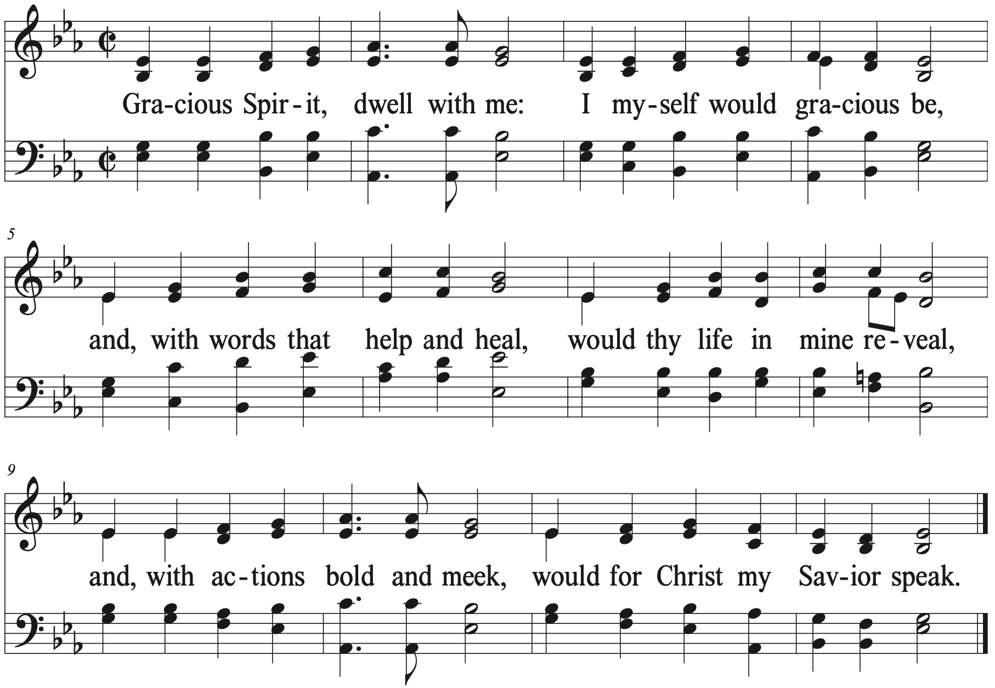

Slide 3
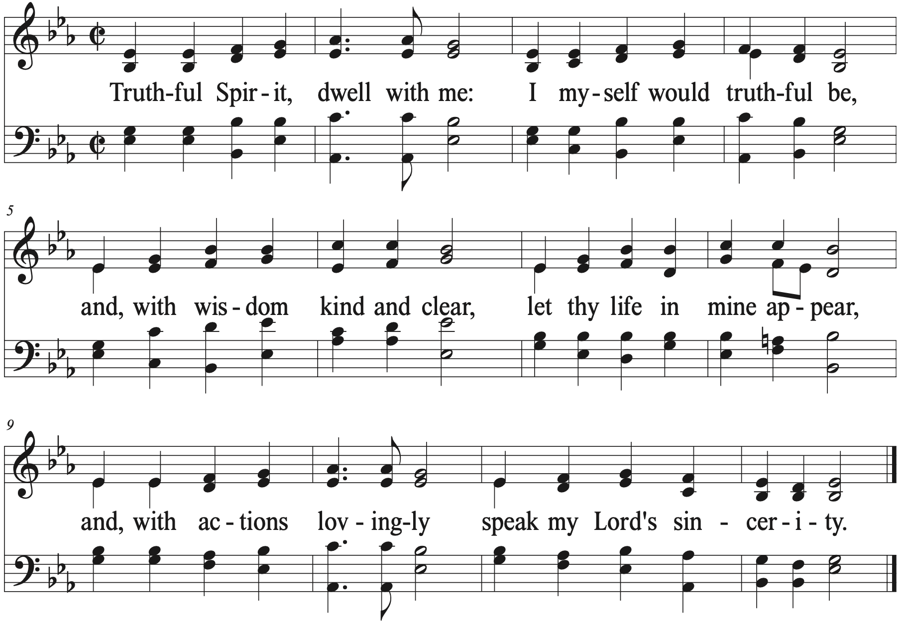

Slide 4
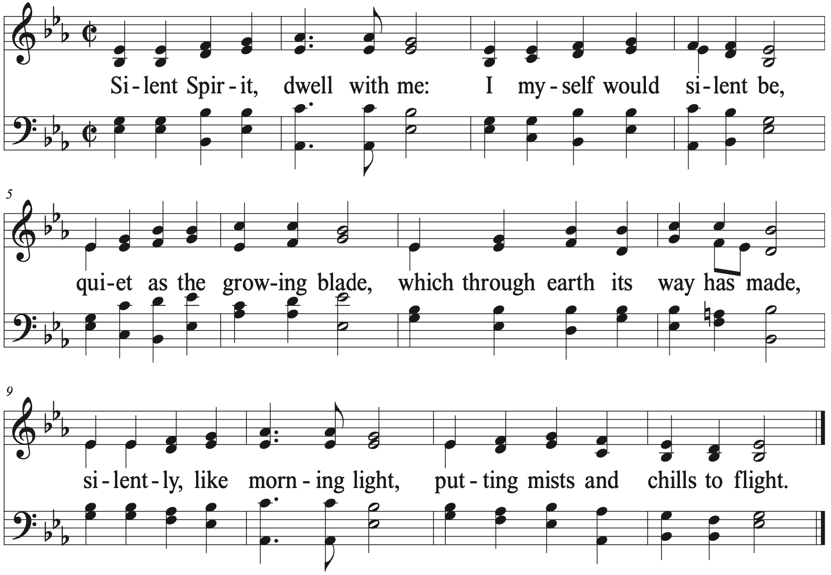

Slide 5
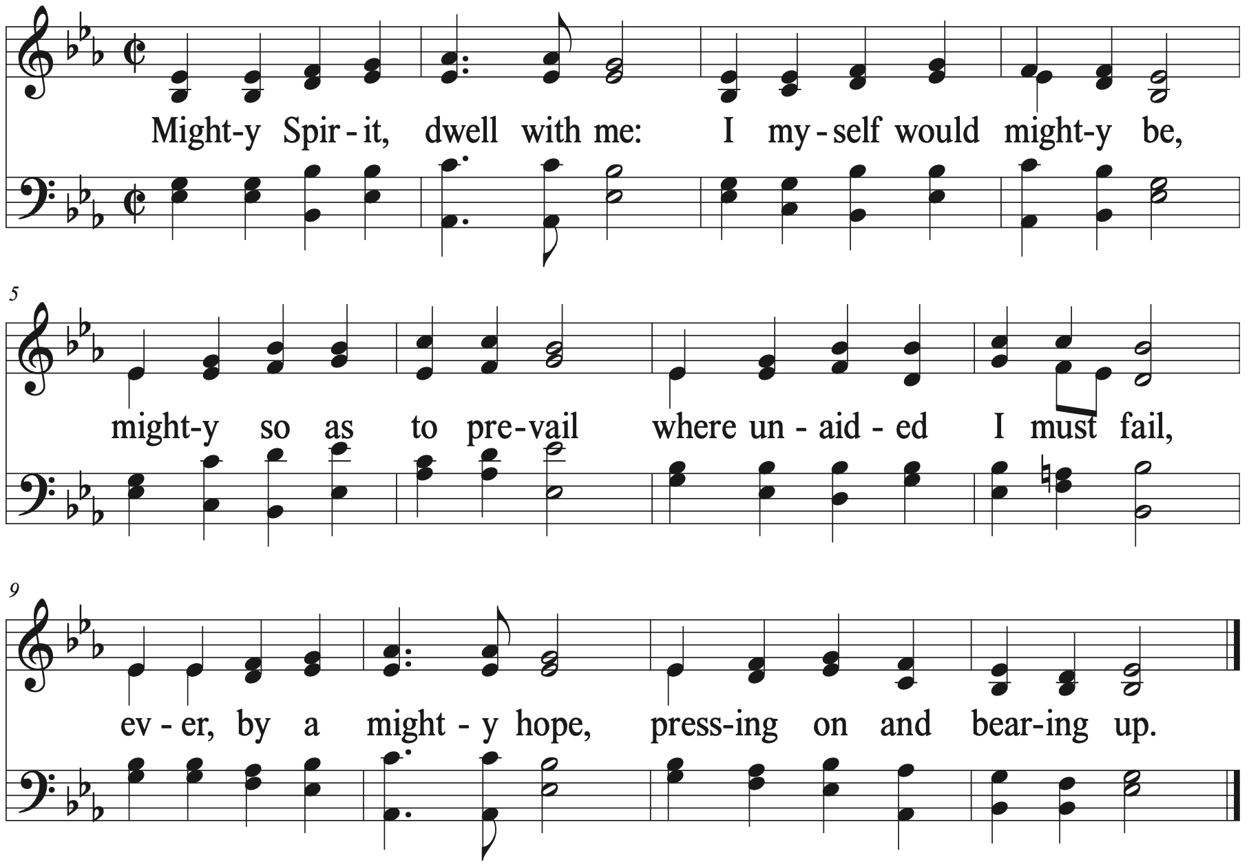

Slide 6
